Slide 1
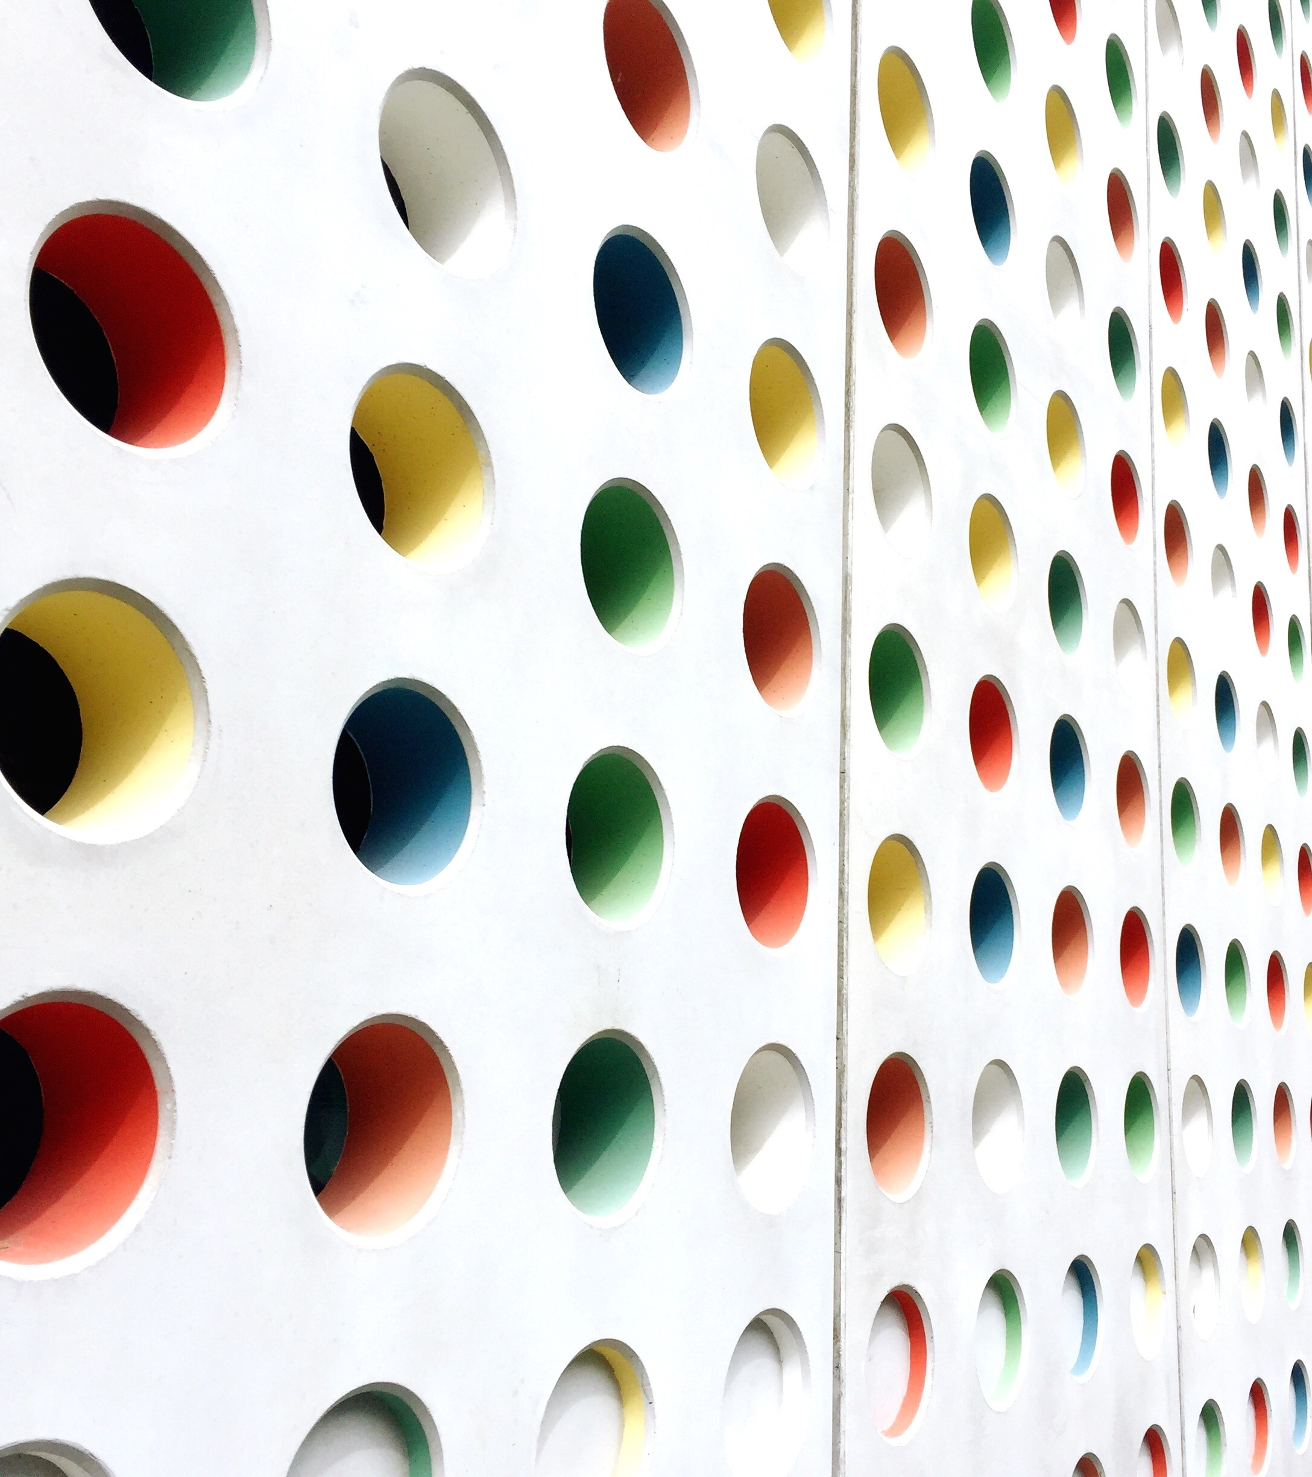
Style Transfer with Neuro Network
Soe Htet Naing
St-125166
Yan Lin Htet
St-125167
2-Dec-2024

Slide 2
Outline of Presentation
Introduction to Style Transfer
Application
Datasets
Methodology
Experimental Results
Conclusion

Slide 3
Introduction to Style Transfer
What is Neural Style Transfer (NST)?
A deep learning technique that blends the content of one image with the style of another to create visually appealing artwork.
Combines artistic and computational creativity to transform digital images.
How Does NST Work?
Uses Convolutional Neural Networks (CNNs) to separate and recombine content and style representations.
Content Image (C): Provides structure and layout.
Style Image (S): Provides artistic patterns (e.g., colors, textures).
Generated Image (G): Output image blending C and S.

Slide 4
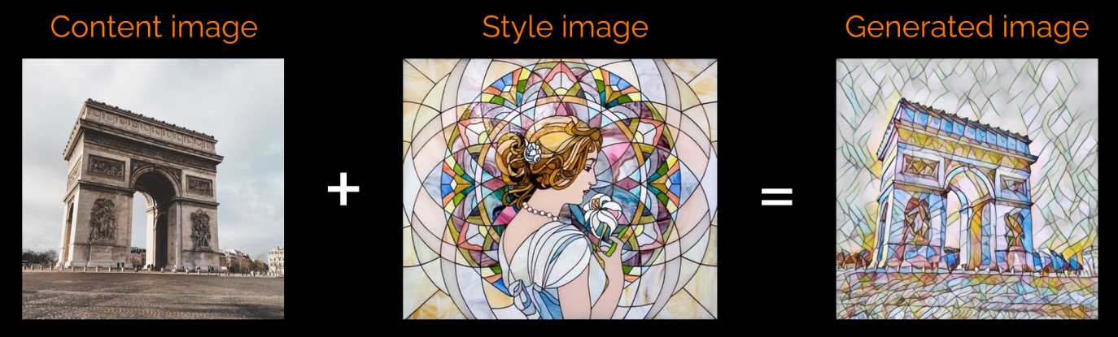
Application of NST
Digital art, photo editing, movie effects, and personalized visual content creation.

Slide 5
Dataset
Training Data:
Source: COCO dataset (test2017 subset) containing diverse unlabeled images.
Purpose: Provides a variety of content images for style transfer experiments.
Preprocessing Steps:
Images resized to 256 × 256 pixels for uniformity.
Normalized using mean and standard deviation to ensure consistency in neural network inputs.
Why COCO Dataset?
Extensive diversity in images aids in training robust style transfer models.

Slide 6
Methodology
Implemented Neural Style Transfer (NST) using a combination of the VGG-16 architecture and a Transformer Network.
Balances content preservation and style integration through optimization techniques.
Model Architecture:
VGG16 Feature Extraction Network:
Extracts hierarchical features from images.
Divided into layers: relu1_2, relu2_2, relu3_3, and relu4_3.
Frozen during training to ensure computational efficiency.
Transformer Network:
Fully convolutional design for single forward pass processing.
Down Sampling Layers: Reduces spatial dimensions using stride convolution.
Residual Blocks: Enhances capacity for complex transformations.
Up Sampling Layers: Restores spatial resolution using transposed convolution.

Slide 7
Content Loss:
Preserves structural details of the content image.
Calculated using activations from relu2_2 of the VGG16 model.
Style Loss:
Matches artistic patterns from the style image.
Uses Gram Matrices to compare texture correlations across multiple layers.

Slide 8
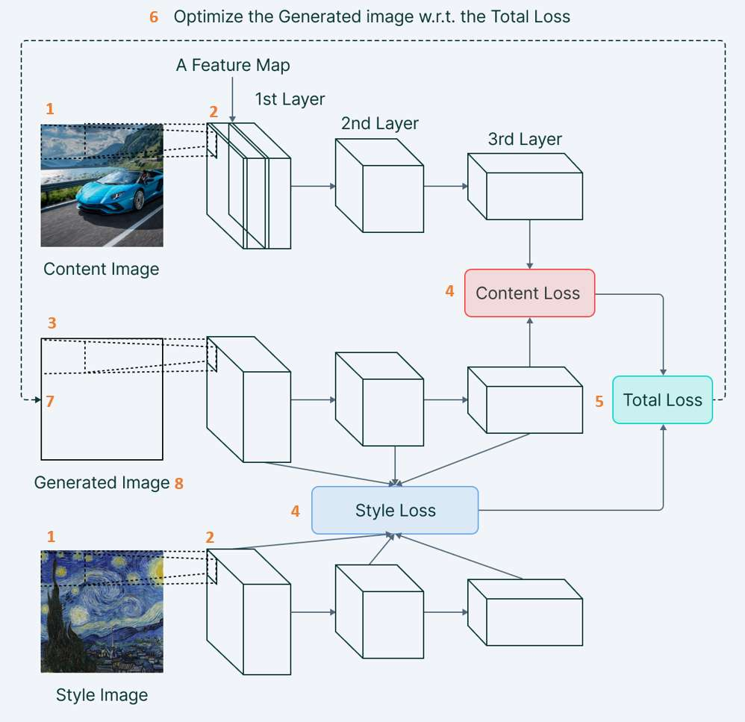

Slide 9
Total Loss Calculation
Purpose: The total loss balances content preservation and style application to achieve visually appealing results.
Content Weight (α): Controls the degree to which the content structure is preserved in the stylized output.
Style Weight (β): Determines the intensity of the applied artistic style.
Key Parameters:
N: Number of filters in the convolutional layer.
M: Size of each feature map.
Process:
Total loss is computed as a weighted combination of content and style losses.
Hyperparameters are tuned to control the trade-off between content and style, optimizing the visual balance in the output.

Slide 10
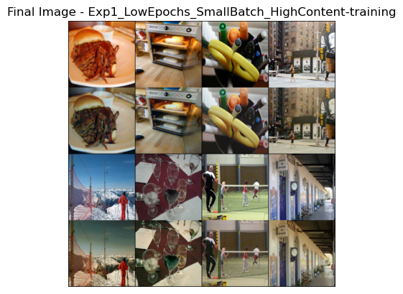
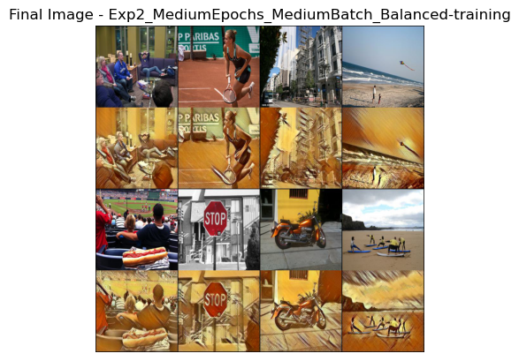
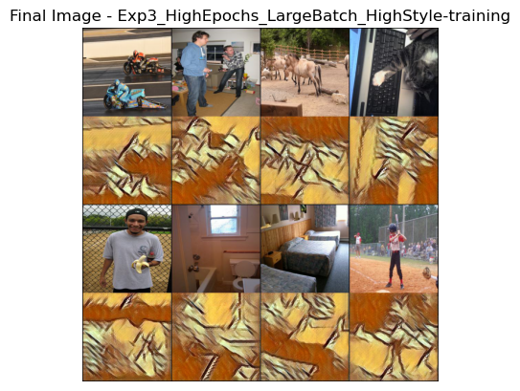
Experimental Results

Slide 11
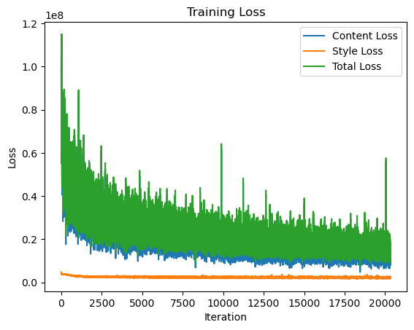
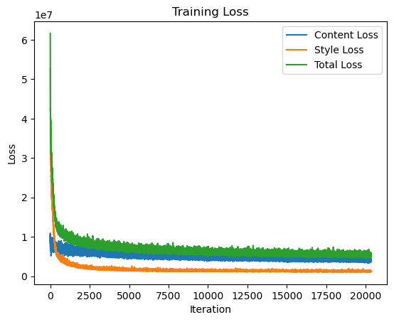
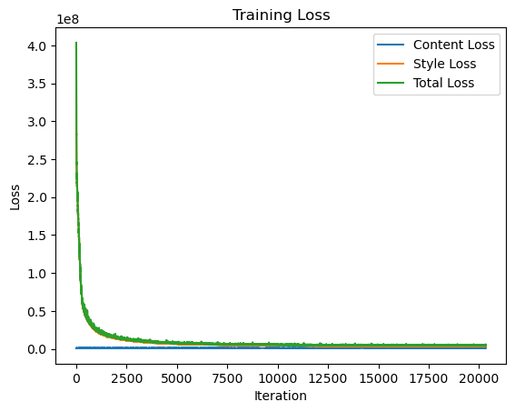

Slide 12
Testing and Visualization
Stylized outputs for test images were generated using the best-performing model.
Tensors were converted back into RGB images for visualization.
Outputs demonstrated the effectiveness of the model in blending content and style seamlessly.

Slide 13
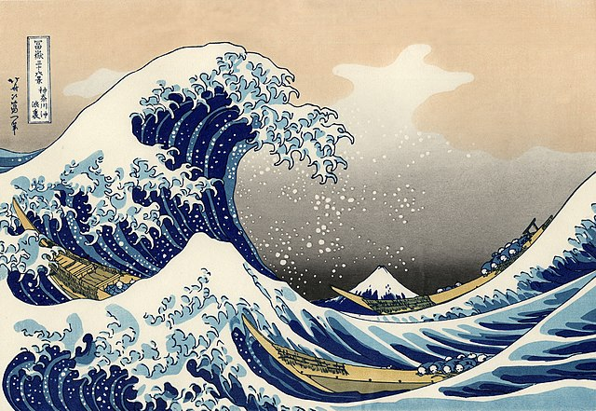
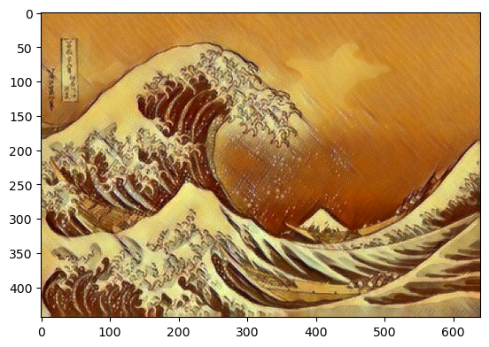
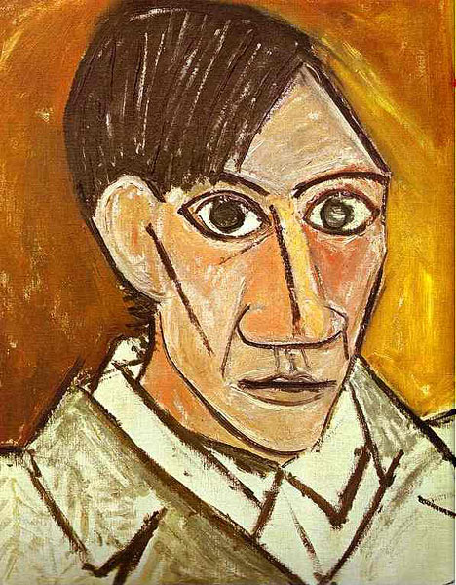
Testing and Results
Content Image
Style Image
Output

Slide 14
Conclusion
Best Model
Exp2: Medium Epochs, Medium Batch, Balanced Weights emerged as the best-performing model, balancing content and style effectively.
Challenges and Solutions
Balancing Loss Weights: Proper tuning of style and content weights ( 𝛼 , 𝛽) was critical to achieving visually appealing results.
Future Work
Extend the experiments to support multi-style transfer and real-time processing.

Slide 15
Thank You

